Slide 1


Security Assessment Briefing for BrainMeld Acquisition
Presented by:
Jarrett Phillips
Cybersecurity Team, Grey Matter
Grey Matter
Notes:
Good [morning/afternoon], everyone. Today, I'll be presenting the findings from our security assessment of BrainMeld, the company we recently acquired. Our goal is to ensure that BrainMeld's network is secure and that we address any vulnerabilities we found. I'll explain the categories of these vulnerabilities and recommend steps we can take to improve BrainMeld's security posture. Let's start with an overview of what we found.

Slide 2

The Beginning
- Overview of the acquisition of BrainMeld
- Importance of security assessment in the context
of the acquisition
- Objectives: To share findings and recommend
actions
Notes:
As you know, we recently acquired BrainMeld, a move that has brought many opportunities for growth. However, with this acquisition comes the responsibility to secure BrainMeld's network. Over the past few months, our cybersecurity team has worked closely with IT to assess BrainMeld's systems and ensure they meet our security standards.

Slide 3
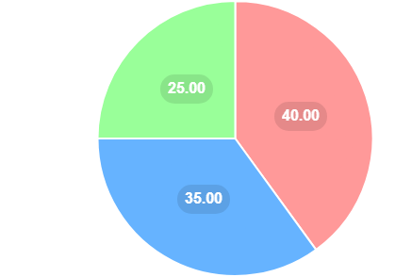
Vulnerabilities
.Scheduled maintenance issues,
.Policy Update Issues
.Other Security Issues
Scheduled Maintenance Issues: Regular updates required for software and hardware.
Policy Update Issues: Need for updated security policies to reduce risks.
Other Security Issues: Various vulnerabilities that pose significant risks.
Notes:
We identified three main categories of vulnerabilities: Scheduled Maintenance Issues, Policy Update Issues, and Other Security Issues. Each category requires specific actions to mitigate risks and enhance security.

Slide 4
Scheduled Maintenance Issues
Vulnerability Name | Description | Actions to be Taken
Microsoft Windows SMB Server NTLM Multiple Vulnerabilities (971468) | Critical vulnerabilities in SMB Server that can be exploited by attackers. | Apply the vendor-provided patch immediately.
MS15-034 HTTP.sys Remote Code Execution Vulnerability (CVE-2015-1635) | A critical vulnerability that allows remote code execution via HTTP.sys. | Install the critical security update from Microsoft.
Microsoft ASP.NET Information Disclosure Vulnerability (2418042) | A vulnerability that can lead to information disclosure in ASP.NET. | Update the ASP.NET framework.
SSL/TLS Weak Cipher | Use of weak cipher suites in SSL/TLS that can be exploited. | Disable weak cipher suites in SSL/TLS
SSL/TLS Certificate with Weak Signature | SSL/TLS certificates with weak signature algorithms that can be compromised. | Replace the SSL/TLS certificate with one that uses a strong signature algorithm.
Issues arising from the need for regular updates
Examples:
Outdated software versions.
Old hardware needing firmware updates.
Importance: Unaddressed issues can lead to easy exploitation by hackers.
Notes:
Scheduled Maintenance Issues arise when software or hardware needs regular updates to stay secure. For instance, outdated software versions and old hardware needing firmware updates. If we don't address these, hackers can exploit known vulnerabilities.
Example: One of the critical issues we found is the Microsoft Windows SMB Server NTLM Multiple Vulnerabilities. To fix this, we need to apply the vendor-provided patch immediately.

Slide 5
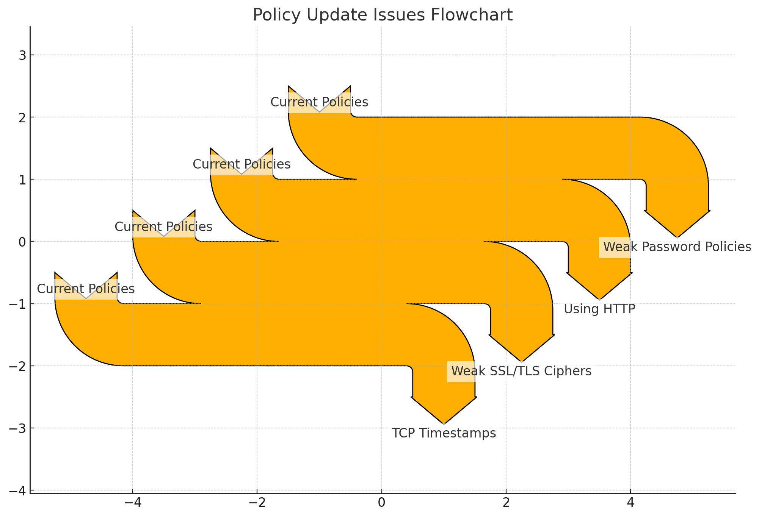
Policy Update Issues
Issues arising from outdated or missing security policies.
Examples: Weak password policies. Using HTTP instead of HTTPS for sensitive communications.
Importance: Outdated policies can lead to insecure practices that are easy targets for attackers.
Notes:
Policy Update Issues arise from outdated or missing security policies. For example, weak password policies and using HTTP instead of HTTPS for sensitive communications. Outdated policies can lead to insecure practices that are easy targets for attackers.
Example: We found instances of SMB Brute Force Logins with Default Credentials. To mitigate this, we need to enforce strong password policies across the board.

Slide 6
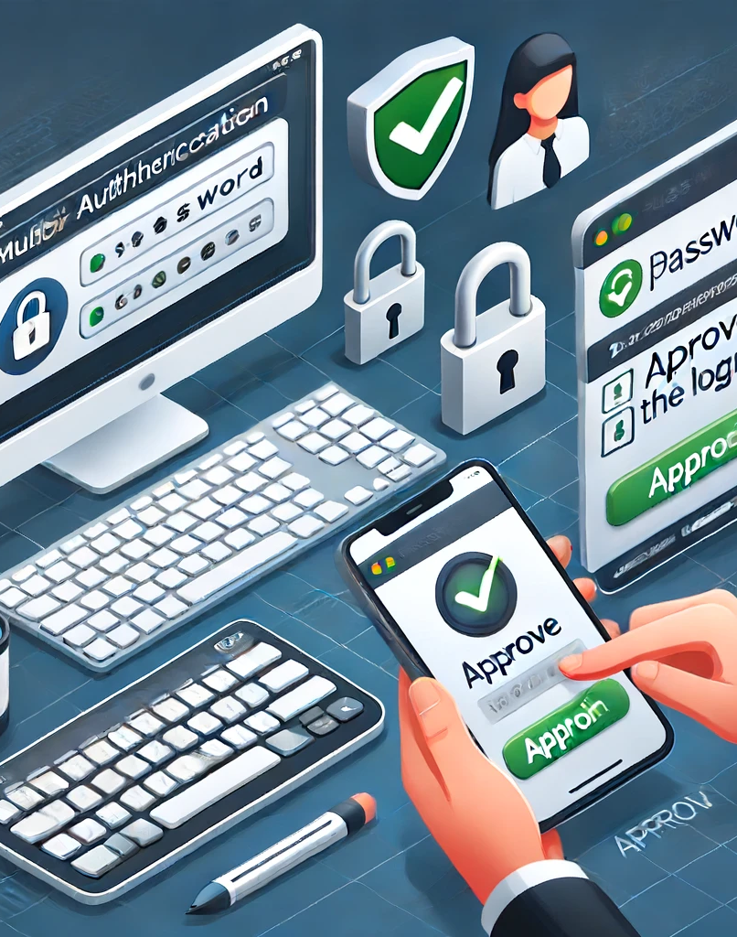
Other Security Issues
.Diverse vulnerabilities that don't fit neatly into other categories but still pose significant risks.
Examples:
- Weak passwords.
-Inadequate network segmentation
. These issues can lead to unauthorized access and data breaches if not addressed.
.MFA and DMZ with use of firewalls
Notes:
These are diverse vulnerabilities that don't fit neatly into the other categories but still pose significant risks. For instance, weak passwords and inadequate network segmentation. Addressing these issues is crucial to prevent unauthorized access and data breaches.

Slide 7
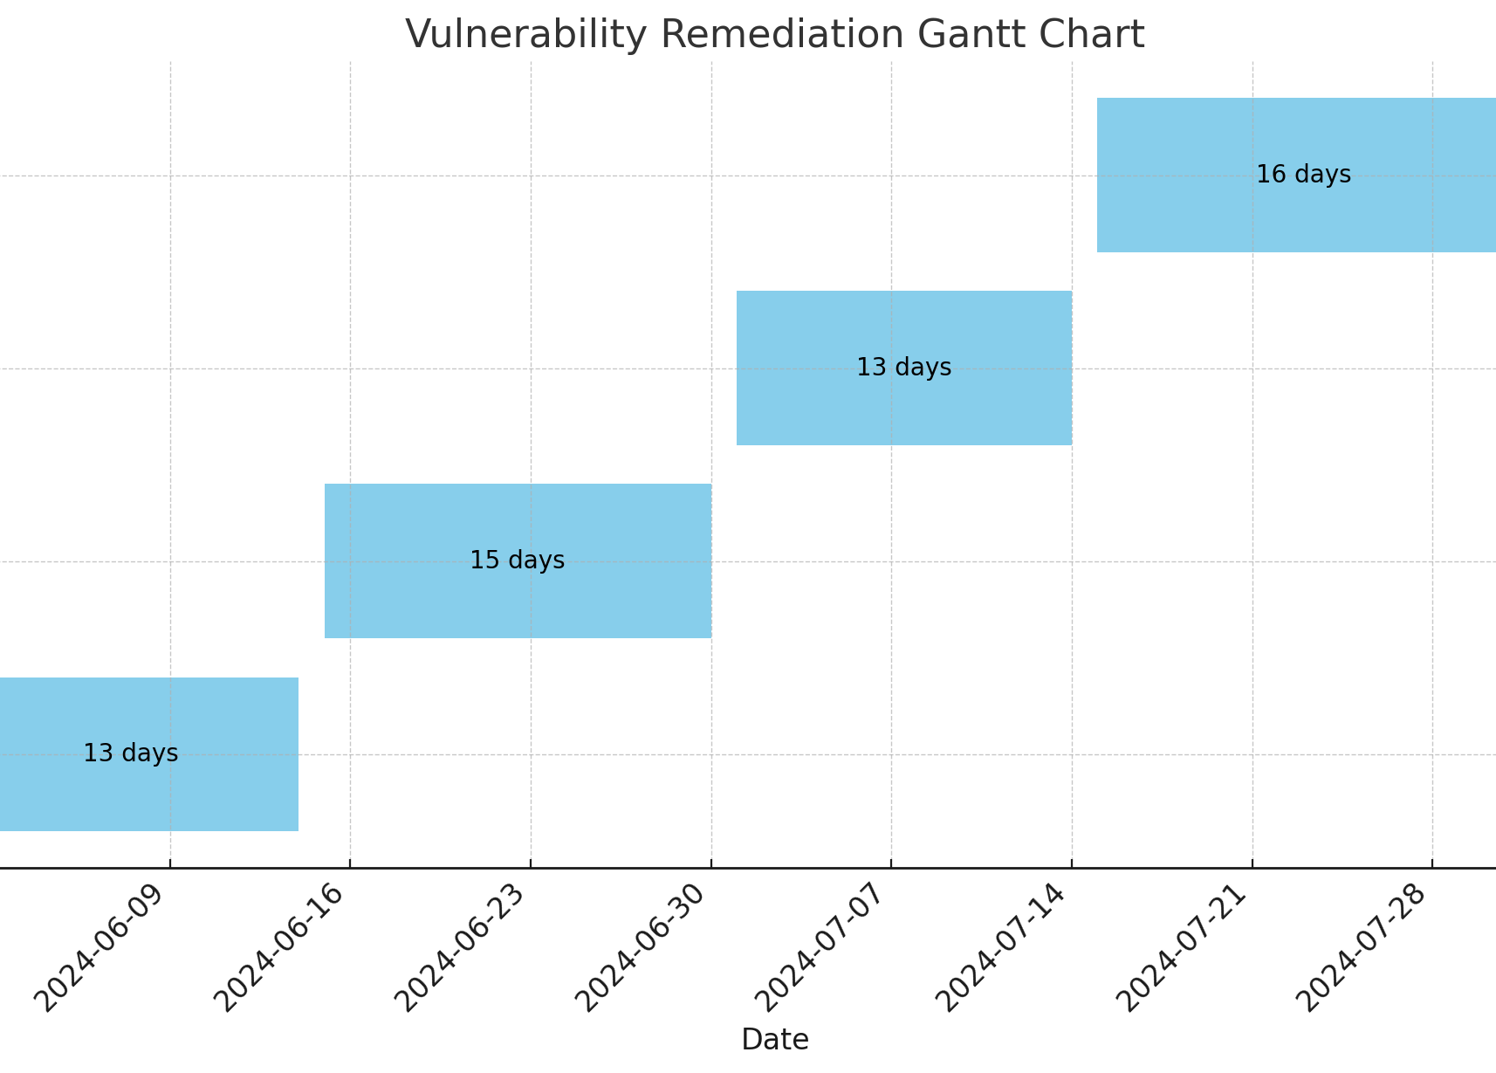
Prioritization of Actions
Immediate Focus: Address Scheduled Maintenance issues first for immediate security improvements.
Next Steps: Update policies and address specific issues like weak passwords and network segmentation.
Implementation Timeline: Detailed timeline for addressing each category.
Notes:
Our immediate focus will be on Scheduled Maintenance Issues, as they can be resolved quickly and will provide immediate security improvements. Next, we'll update policies and address specific issues like weak passwords and network segmentation to further strengthen our security. From the top of the Gannt chart down the list would Network Segmentation, Implement strong passwords and MFA, Update security policies, and Address Scheduled maintenance issues. I tried adding it into the graph but it would not all fit within the slide.

Slide 8
Story Time
An employee at my last job brought his own laptop to work because it was faster and more convenient for him. Unfortunately, his personal laptop didn’t have the same security measures that our company devices did, specifically MFA.
One day, the laptop got infected with malware through a simple email attachment. The malware stole his password and, since his laptop didn’t have MFA, the attackers were able to access our company's network using his credentials. It was chaotic. The attackers quickly moved through our systems, accessing sensitive data and causing significant disruption. We had to shut down parts of our network to contain the breach, which led to downtime and loss of productivity. It took us weeks to fully recover and secure our systems again.
Notes:
To emphasize the importance of these actions, let me share a brief story. A few years ago, I was part of a team that faced a significant security breach due to outdated software. The breach led to substantial data loss and operational disruptions. It taught us the critical importance of regular maintenance and proactive security measures.

Slide 9
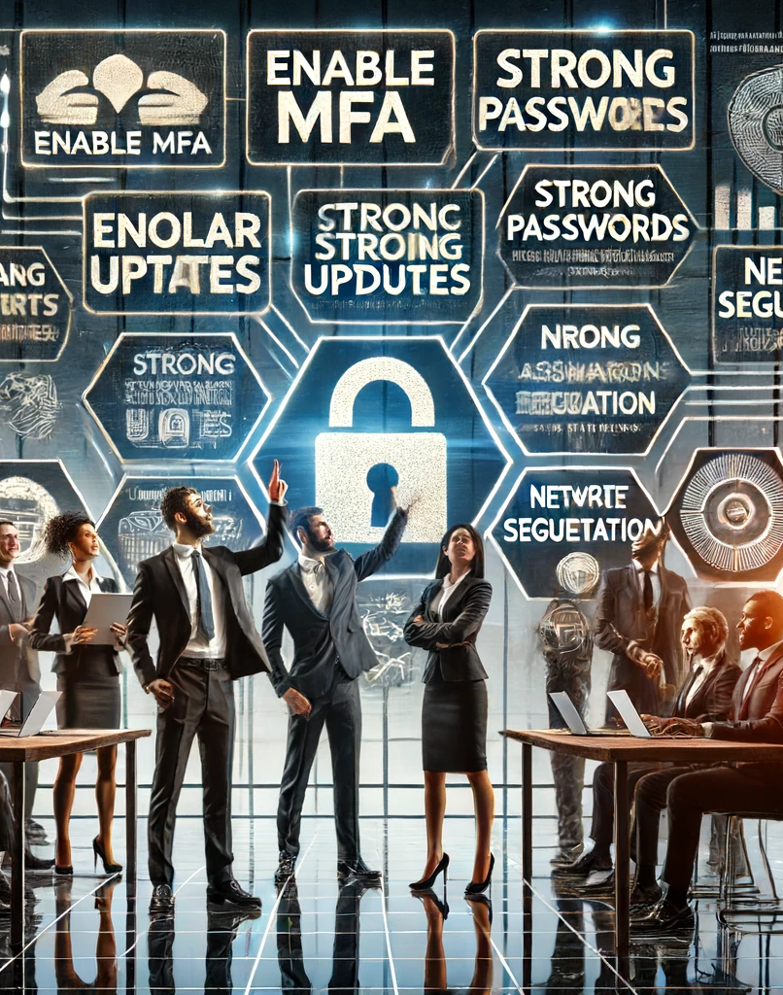
Conclusion
Recap of key points
Importance of addressing vulnerabilities.
Immediate actions and next steps.
Notes:
In conclusion, addressing these vulnerabilities is essential to safeguard our operations and data. By taking immediate action on Scheduled Maintenance Issues, updating our policies, and resolving other security issues, we can enhance our security posture and ensure the success of our acquisition.

Slide 10
Questions and Thank You
Invitation for questions from the audience.
Closing remarks and thank you message.
References: “How to Give a Pretty Good Presentation: A Speaking Survival Guide for the Rest of Us” By T.J. Walker https://learning.oreilly.com/library/view/how-to-give/9780470597149/?sso_link=yes&sso_link_from=SNHU
“How to Present Security So People Will Listen — and Take Action” By Dan Lohrmann https://www.govtech.com/blogs/lohrmann-on-cybersecurity/how-to-present-security-so-people-listen.html
“How to Present Information Security Topics to a Non-Security Audience” By Martin McKeay(2014) https://securityintelligence.com/how-to-present-information-security-topics-to-a-non-security-audience/
Notes:
Thank you for your attention. I'm happy to answer any questions you may have. Let's work together to ensure our systems are secure and resilient.

